Slide 1
Team 3 Megalodon

Slide 2
PROJECT: GAME SHOP
Members:
1. Nguyễn Phát Đạt
2. Dương Ngọc Nguyên Phương
3. Nguyễn Văn An
4. Hà Vũ Đạt
5. Nguyễn Hữu Sơn

Slide 3
OVERVIEWS
Classification | Content
Service | Display various games with recommended options, payment method, discount, feedback.
Background | We’re trying to combine user-friendly and aesthetically-pleasing features, ensure your account privacy.
Purpose | Help customer easy to search game product, providing qualified games for customer with many different competitive level of price.
Expectation | Increasing approaching ability with many type of clients, help save the time and effort for shop’s owner, increasing profit and earning for shop.
Main functions | + Login/Register/Logout. + Manage Game Products + Cart (Buy, Edit), Payment + Search + Statistics, Manage users, Category, comments, Blog (News)
Targeted clients | Concerned objects
Service channel | Web
Publishing time | 23/07

Slide 4
FLOWCHART

Slide 5
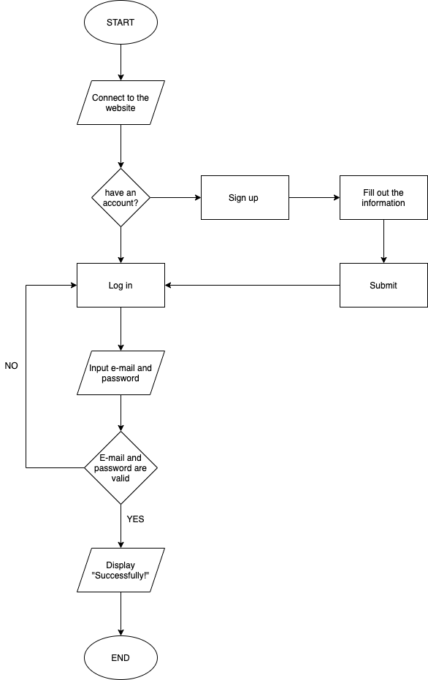
FLOWCHART
LOGIN

Slide 6
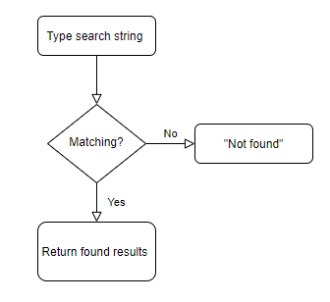
FLOWCHART
SEARCHING

Slide 7
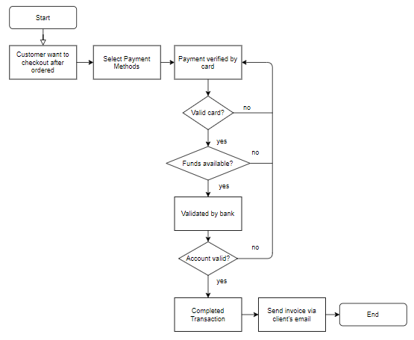
FLOWCHART
PAYMENT

Slide 8
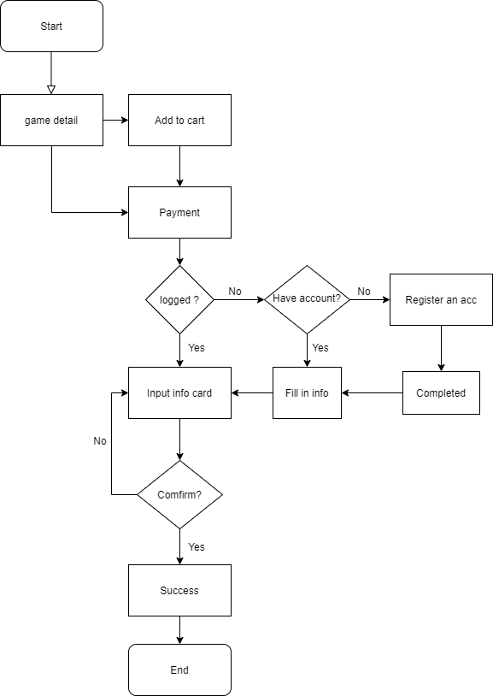
FLOWCHART
BUY GAME

Slide 9
USE-CASE
Notes:
chỉnh lại luồng đi với 4 câu hỏi who-how-what-where
tính liên kết giữa story board và db.

Slide 10
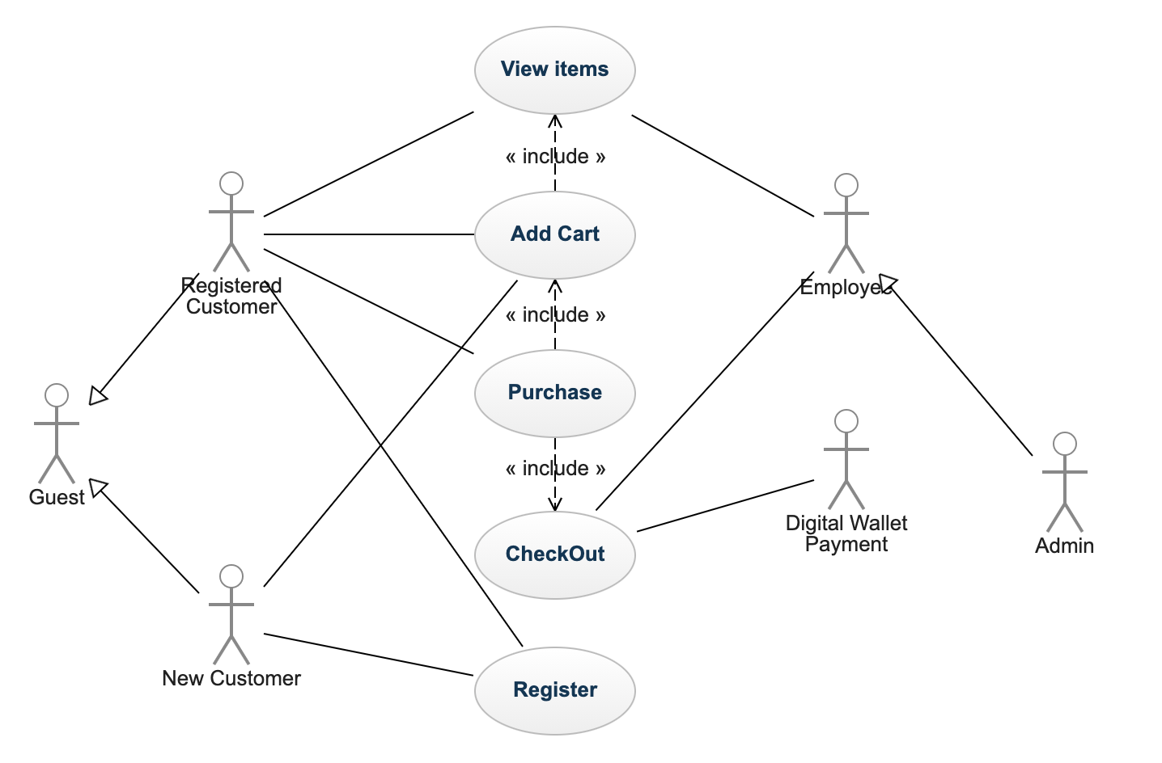
USE-CASE DIAGRAM
WEB CUSTOMER

Slide 11
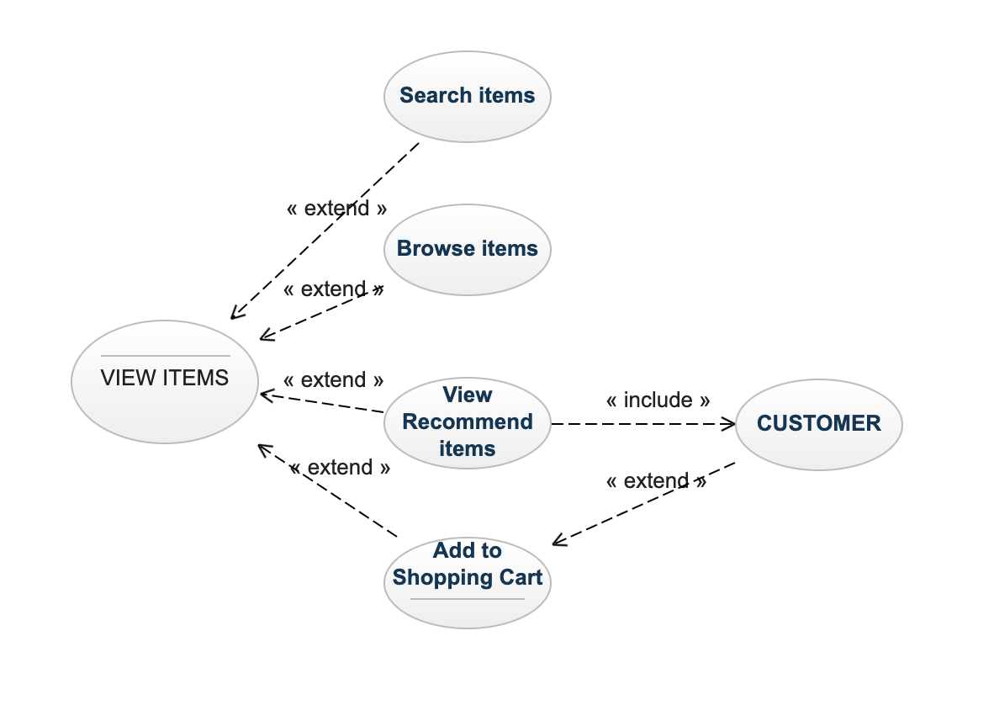
USE-CASE DIAGRAM
VIEW ITEMS

Slide 12
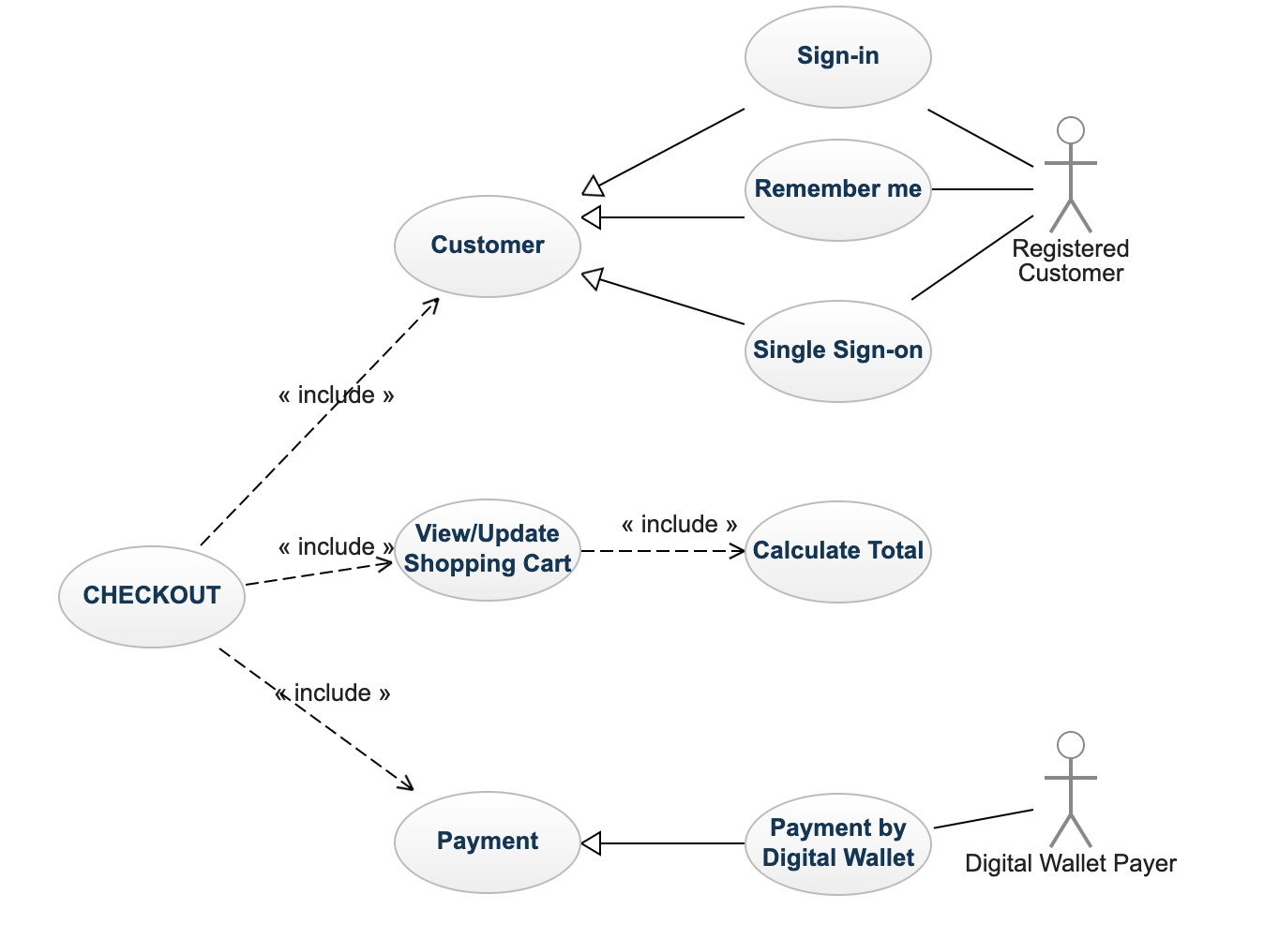
USE-CASE DIAGRAM
CHECKOUT

Slide 13
story board

Slide 14
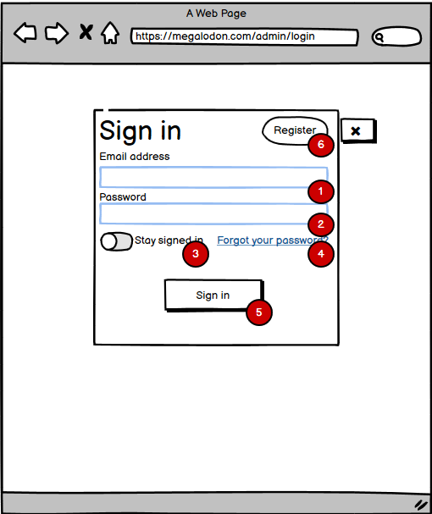
Log in
Description:
Input email account to login: Typing gmail Admin account, employee gmail account.
Input password to login: Typing Admin password or employee password.
Button to save account and password: Used to save accounts and passwords on the local computer.
The link for forgot password case: Go to a web page and restore the former password.
Sign in Button: Used to login with suitable account and password go to indexAdmin page.
Button Register account:
Used to go to the Register section, used to create an account.

Slide 15
Admin Page

Slide 16
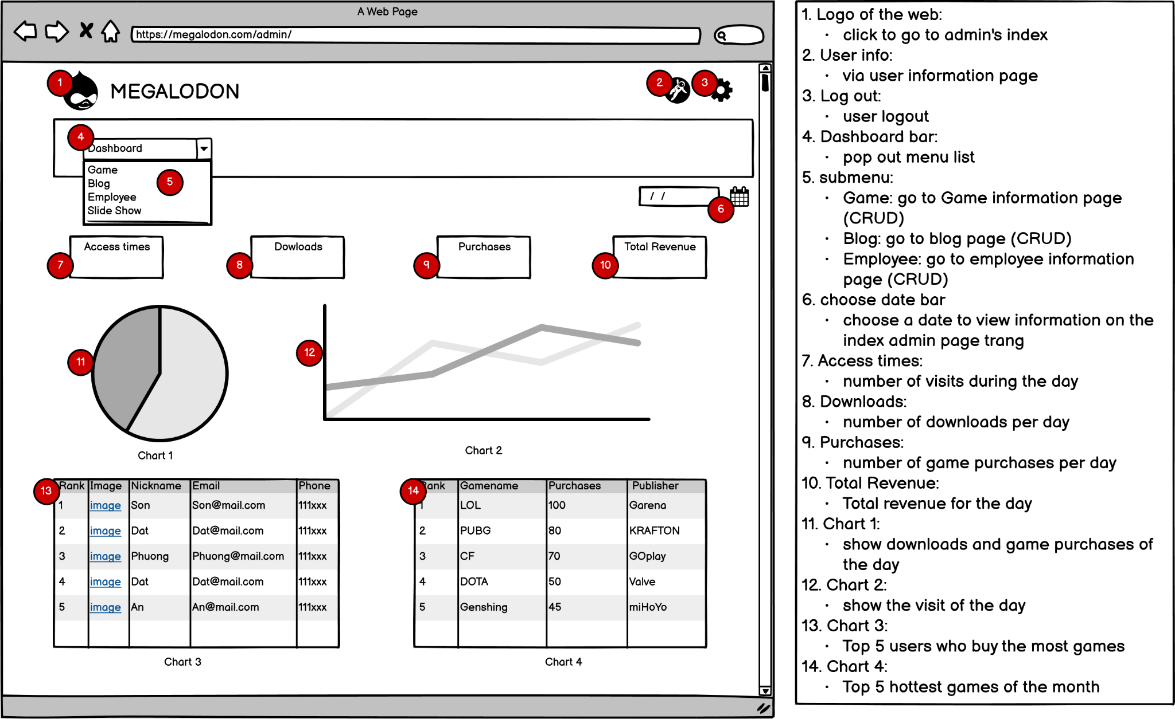
ADMIN HOME

Slide 17
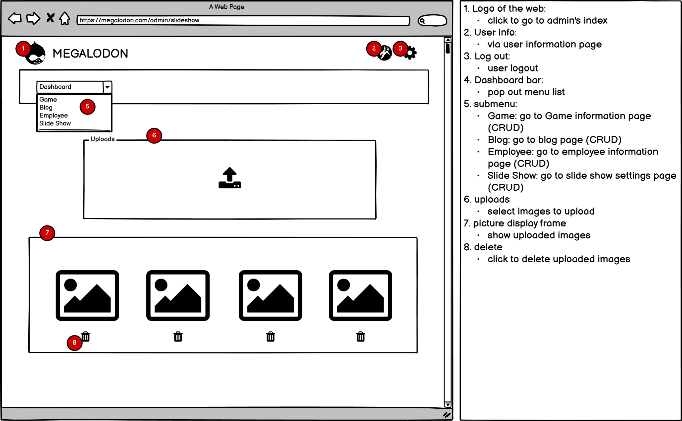
Manage slideshow

Slide 18
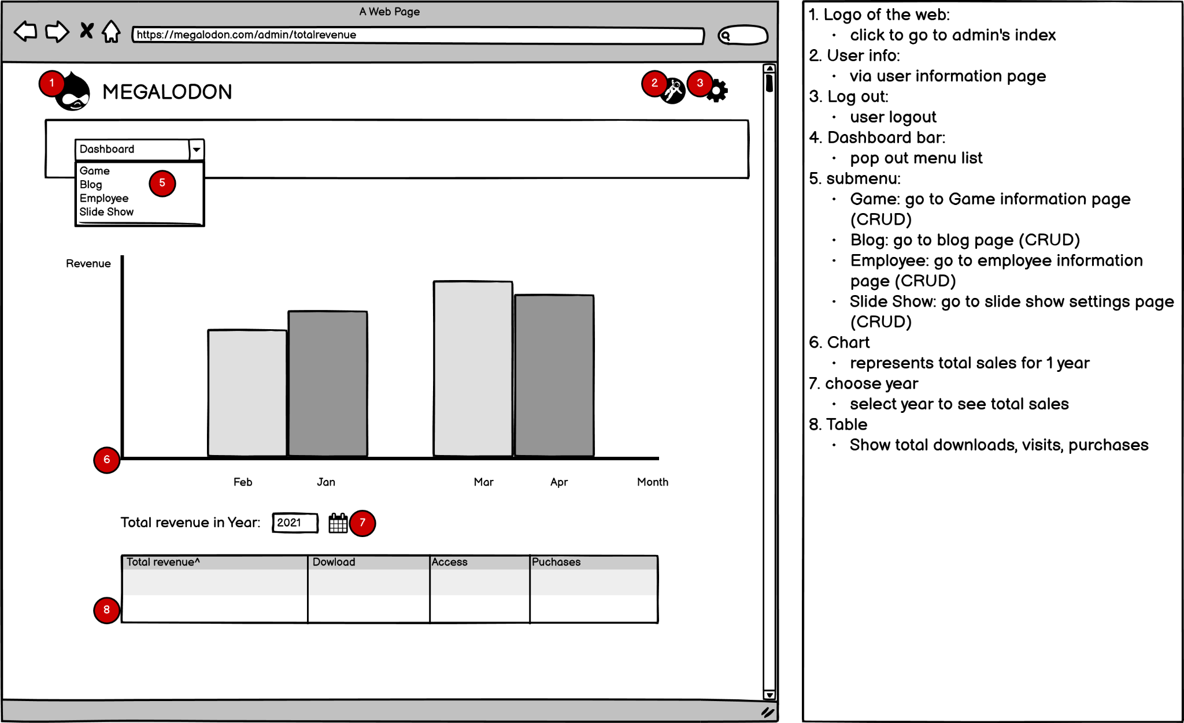
revenue statistics

Slide 19
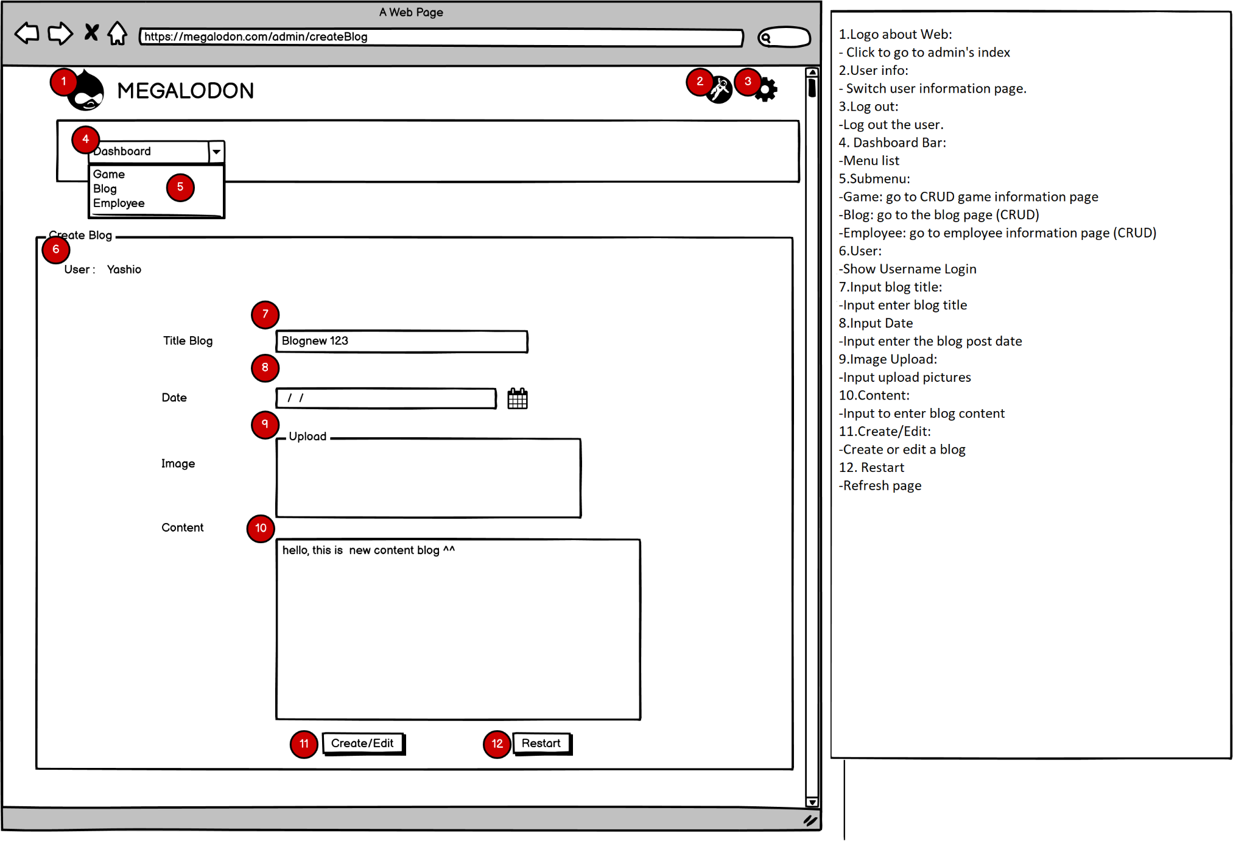
MaNage Blog

Slide 20
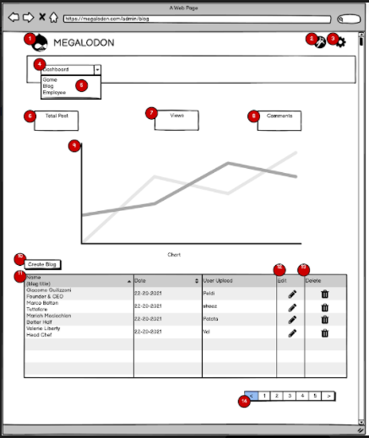
MAnage blog 2
Description:
Web logo: Click it to go to Admin Index page.
User Info: forwarding to user information page
Logout: log out current user.
DashBoard bar: drop menu items list down.
SubMenu:
Game: forwarding to Game management.
Blog: forwarding to Blog management.
Employee: forwarding to Employee management.
Total post: show total number of Posts.
Views: show total number of views.
Comments: show total number of comments.
Chart displays views by month.
Create Blog: go to New Blog page.
Table List Blog: display Blog List
Edit: go to edit corresponding Blog.
Delete: remove selected Blog.
Paging for showing Blog list by table.

Slide 21
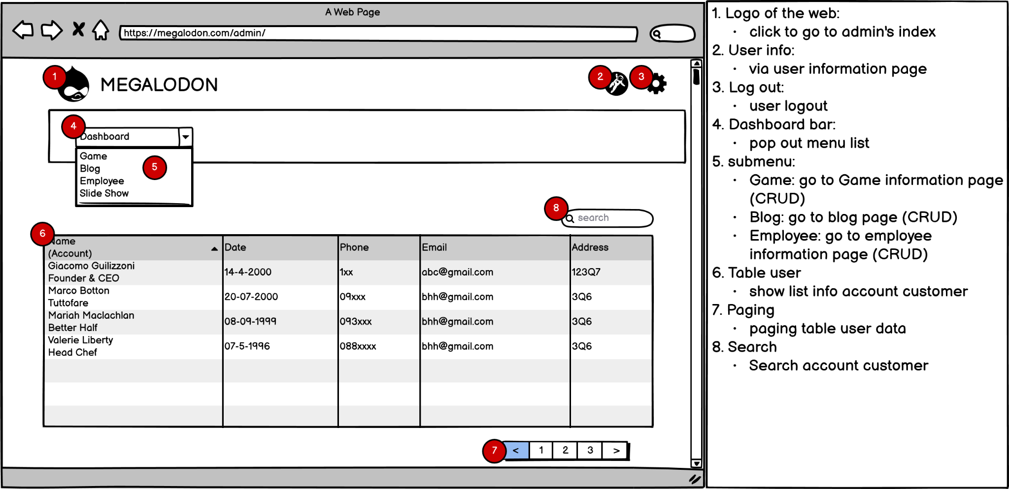
Manage admin

Slide 22
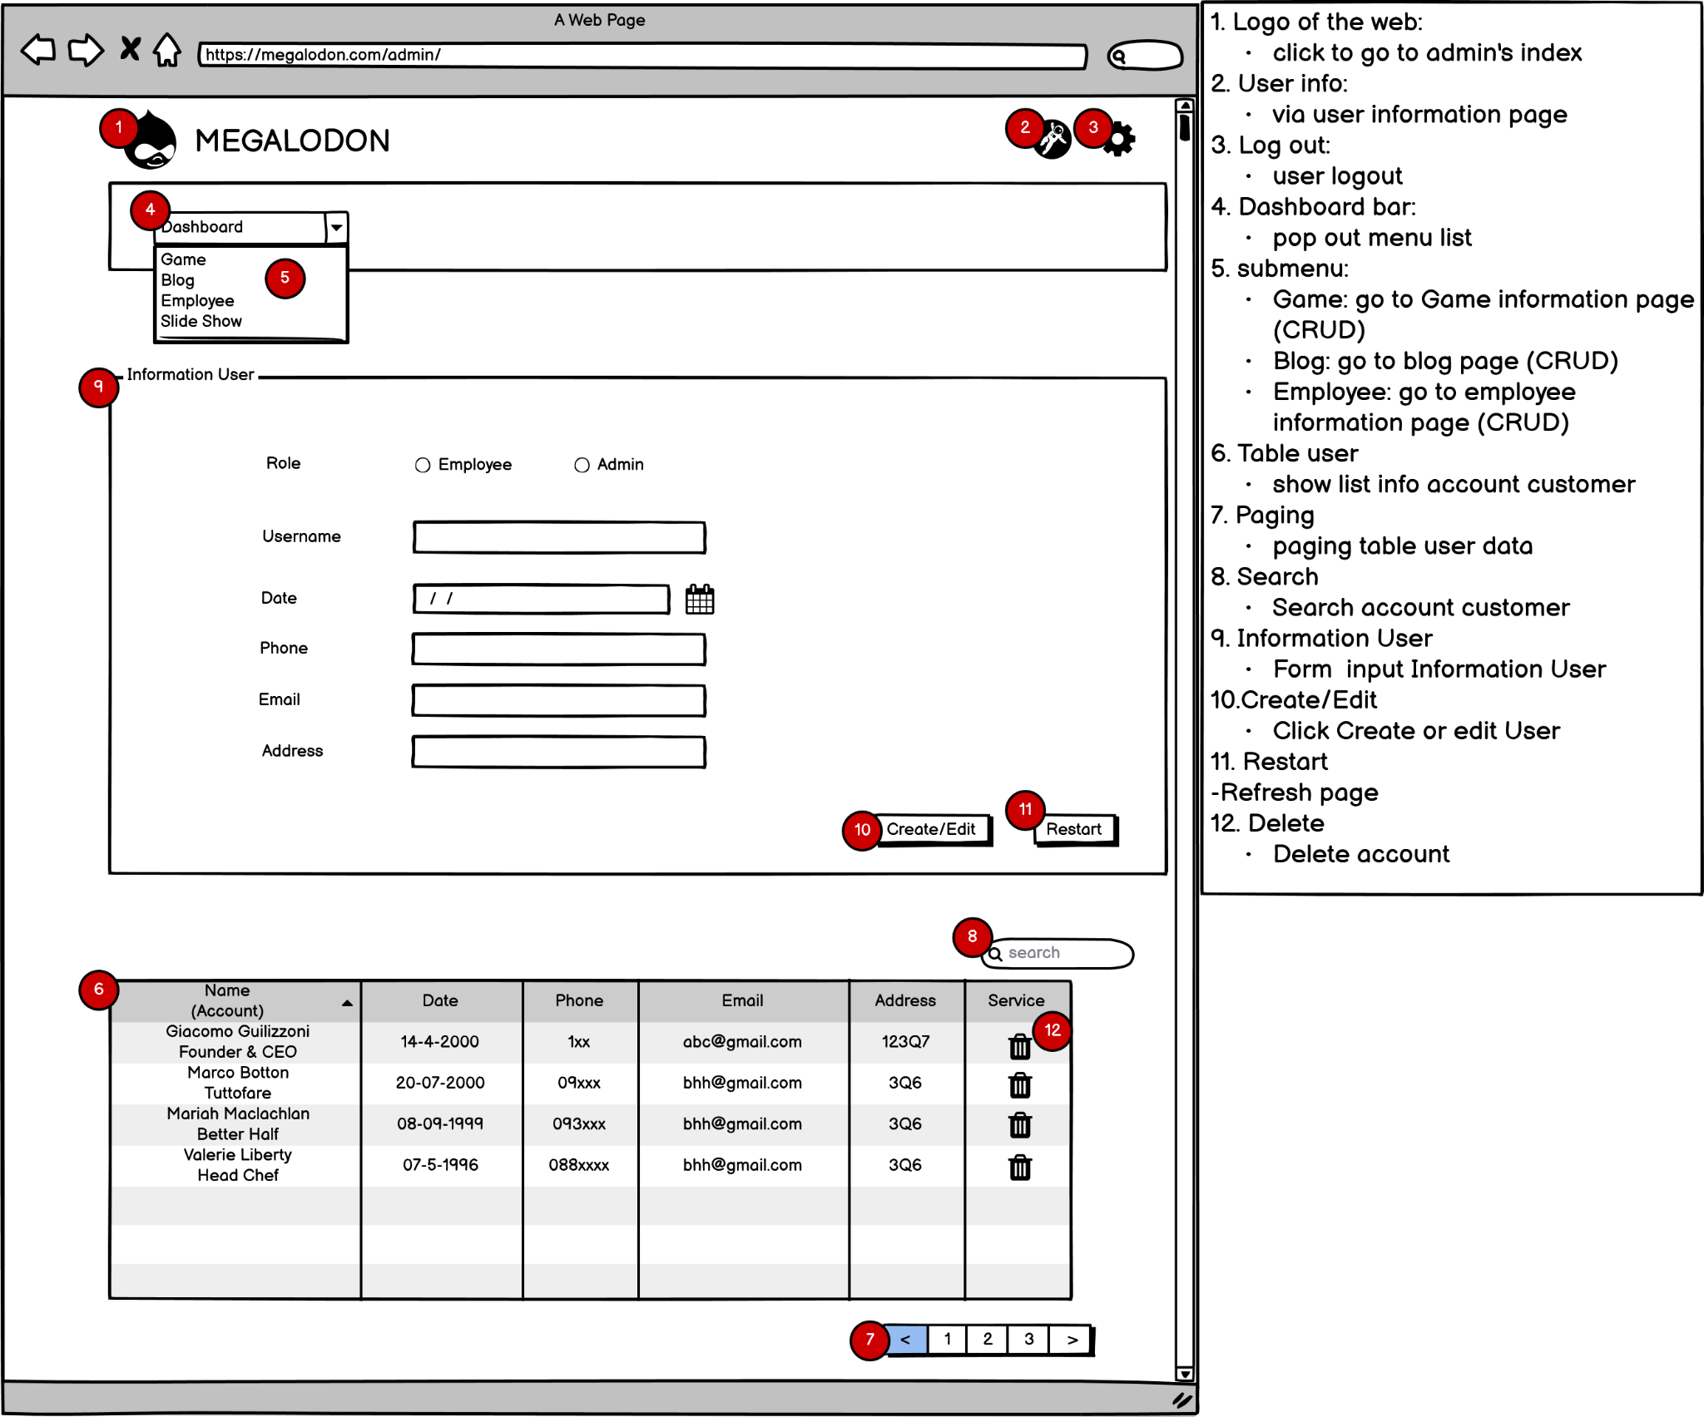
Manage user

Slide 23
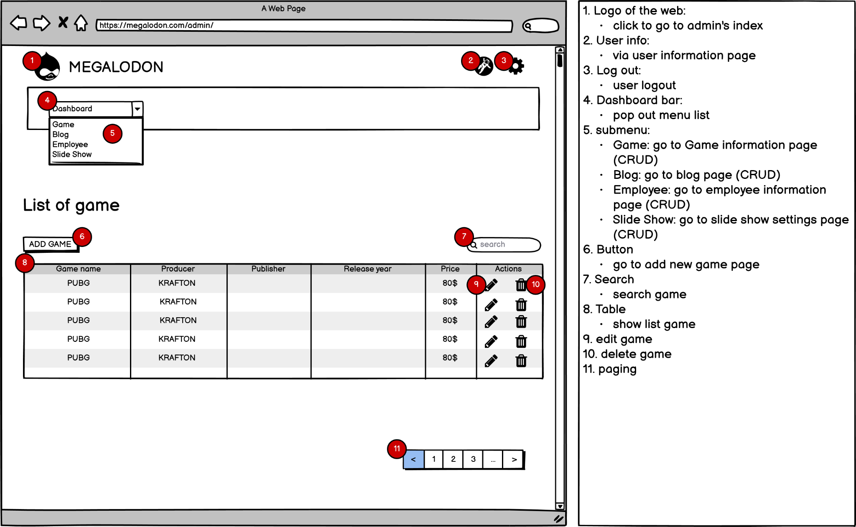
Manage game 1

Slide 24
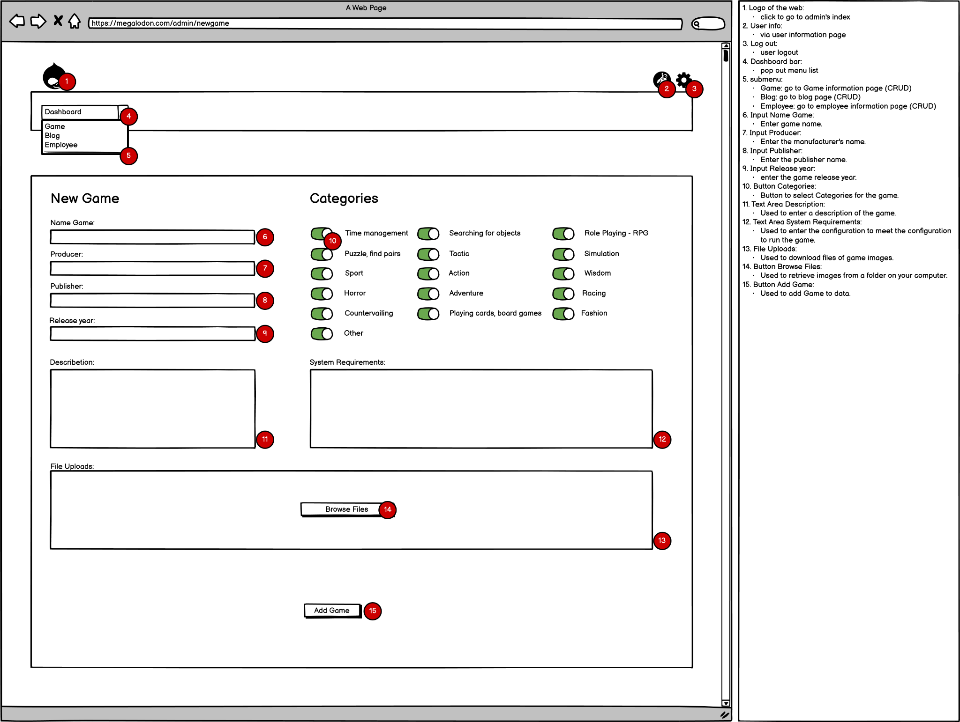
Manage game 2

Slide 25
game shop

Slide 26
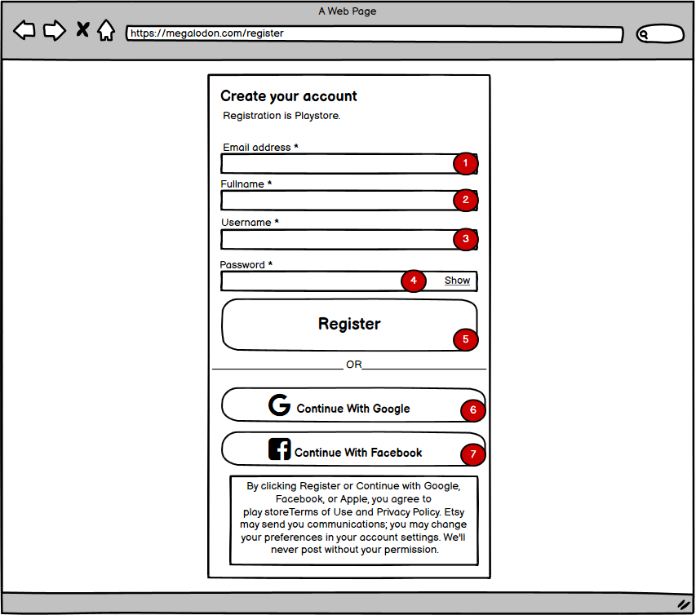
register
Description:
1. Input Email to register:
Enter the Email you want to create.
2. Input Fullname to register:
Enter your full name.
3. Input Username to register:
Enter the name in your website.
4. Input Password to register:
Enter your Password
Button show:
Used to let you review your password.
5. Button Register:
Used to create a new user or create an employee.
6. Google Email Account Button:
Link to google.
7. Facebook Email Account Button:
Link to Facebook.

Slide 27
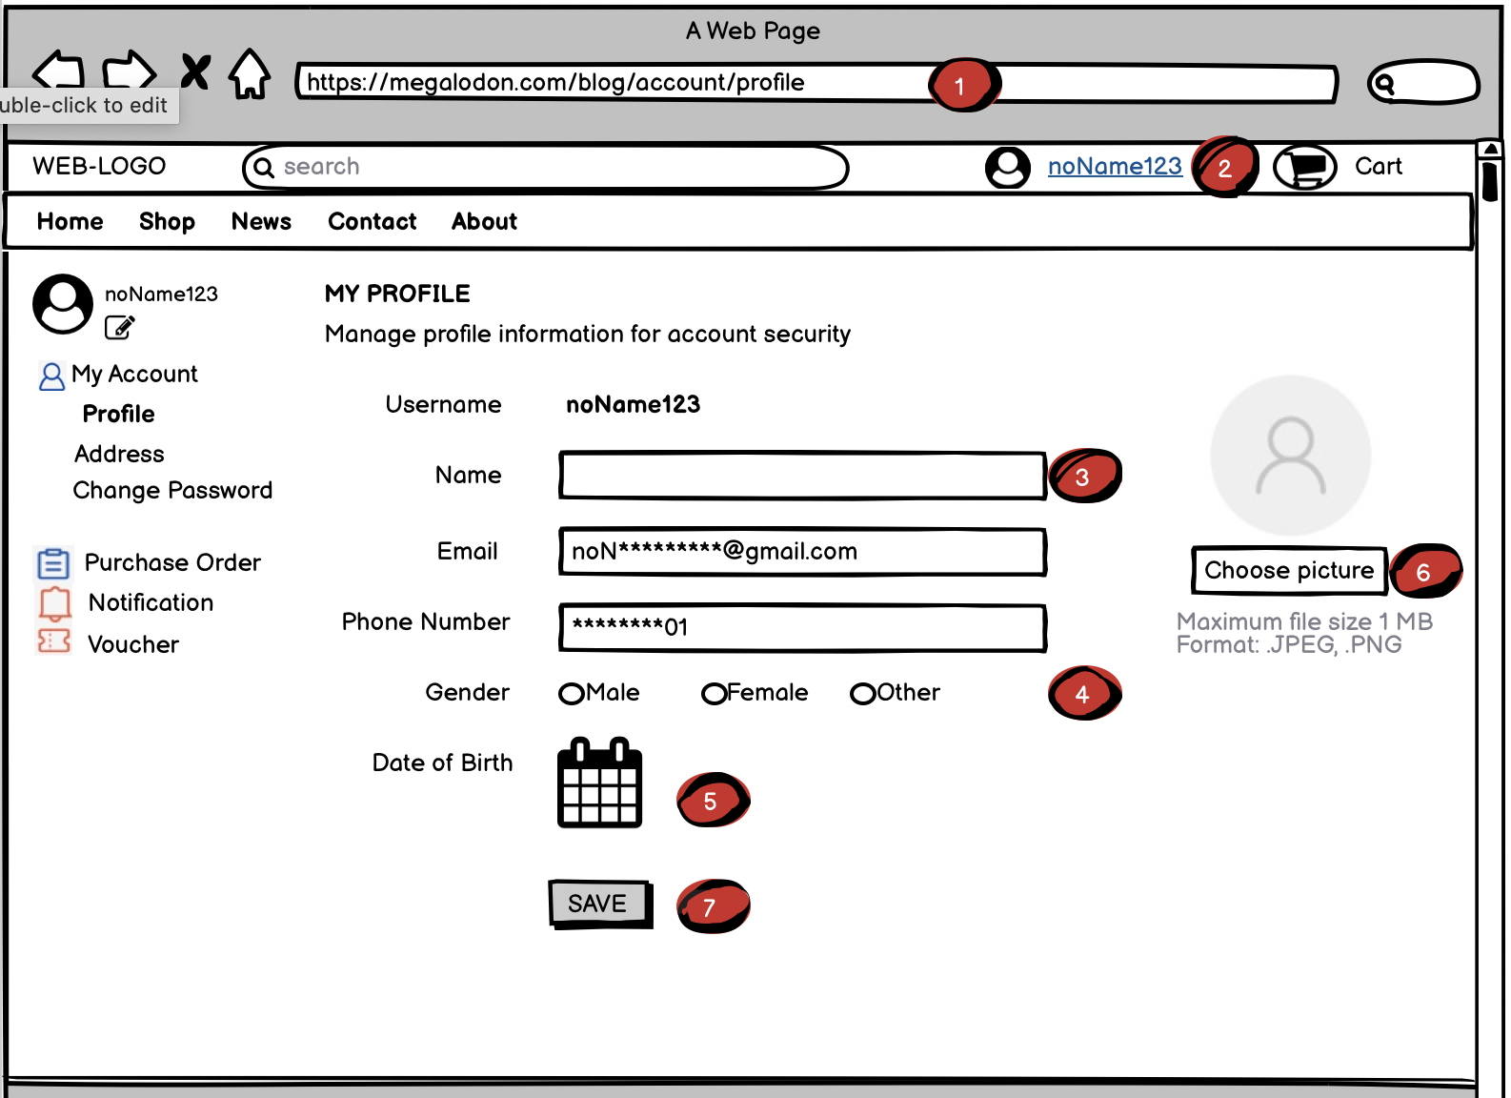
user account
DESCRIPTION (Account)
1. Firstly, visit the link to the Homepage.
2. Log-in successfully.
3,4,5,6. After choose “edit profile” when you move your mouse into <2>, you’ll see these info, it’s up to you to choose edit any things here.
7. Click this button to transport the database to our browser.

Slide 28
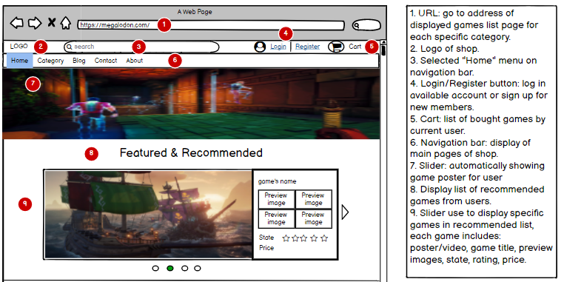
Home Page 1

Slide 29
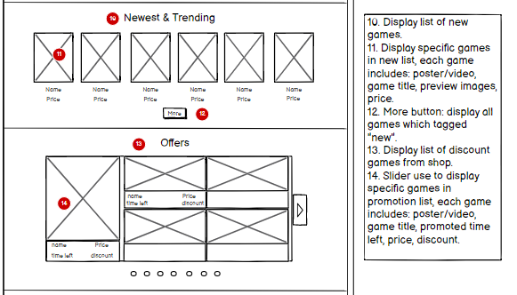
Home Page 2

Slide 30
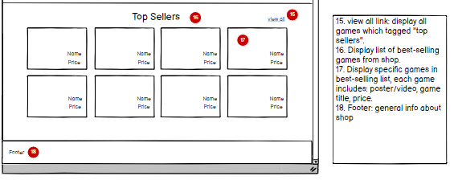
Home Page 3

Slide 31
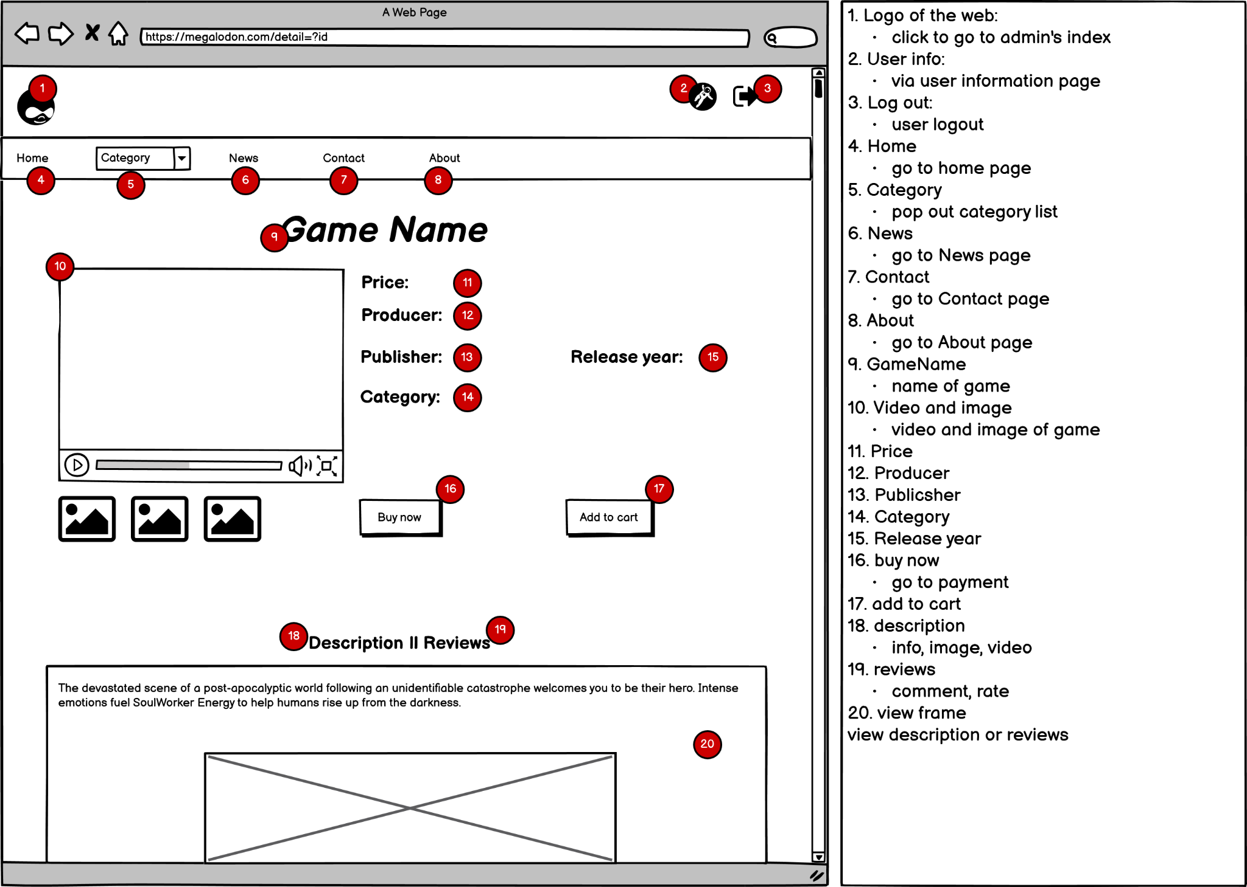
game details

Slide 32
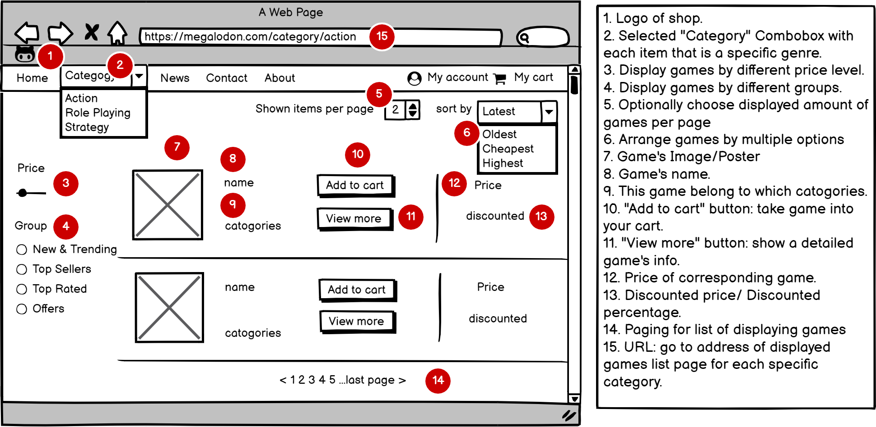
Category game

Slide 33
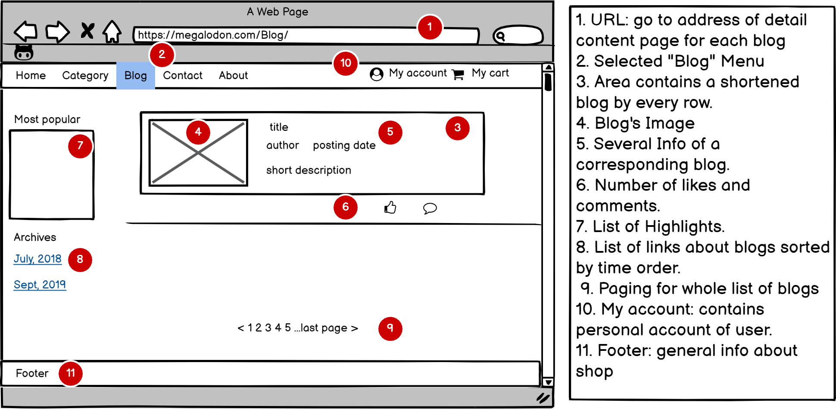
Blog

Slide 34
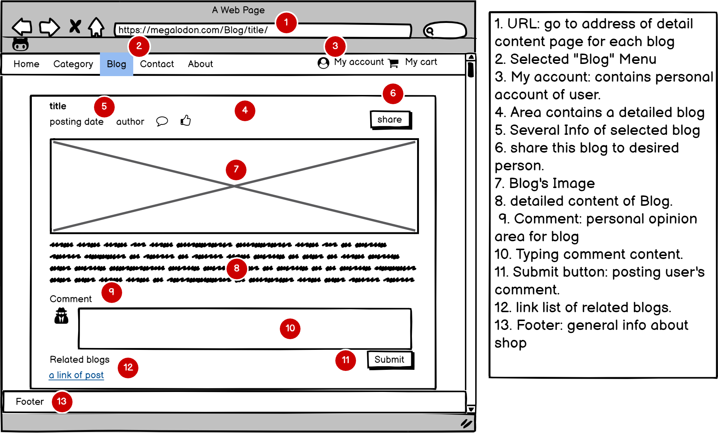
blog details

Slide 35
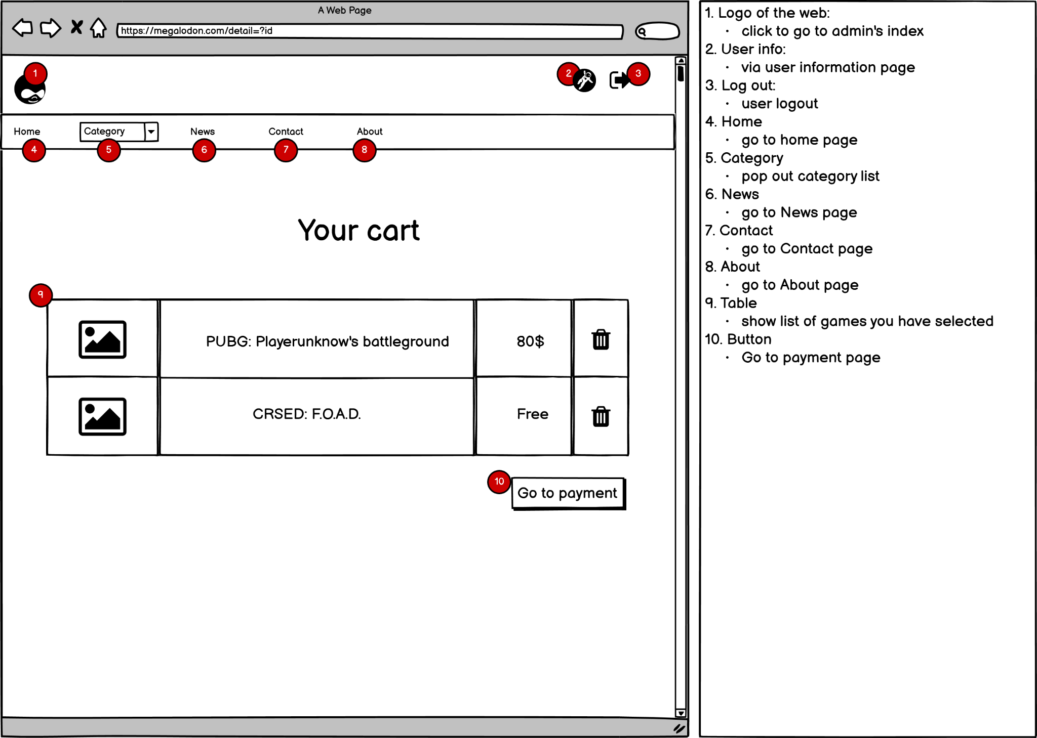
cart

Slide 36
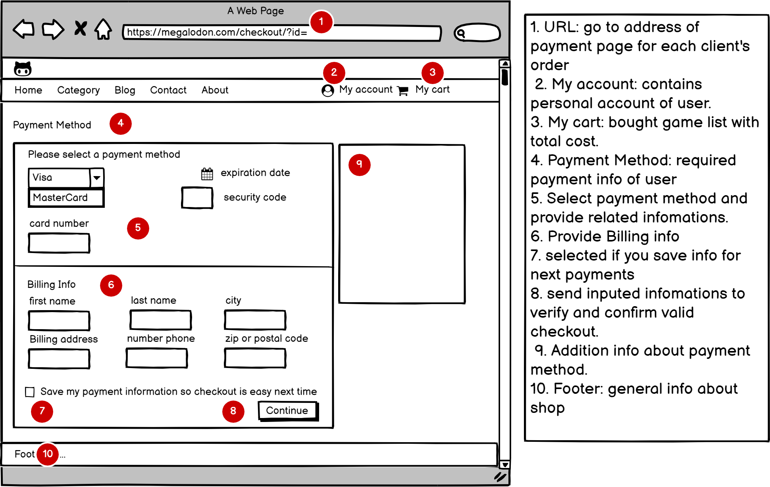
check
out

Slide 37
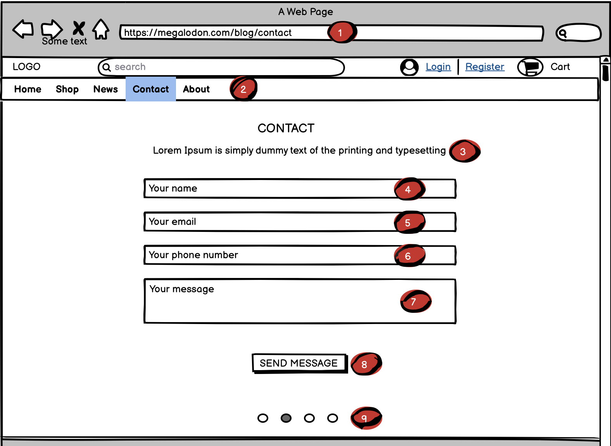
contact
DESCRIPTION (Contact)
1. Firstly, visit the link to the Homepage.
2.Click “Contact” to access this section page.
3. This may contains some details about our contents to section “Contact”
4,5,6,7. You’ll type your information and desire in here to contact us
8. Click this button to transport the above databases to us.
9. The information will shaded with your each mouse’s move.

Slide 38
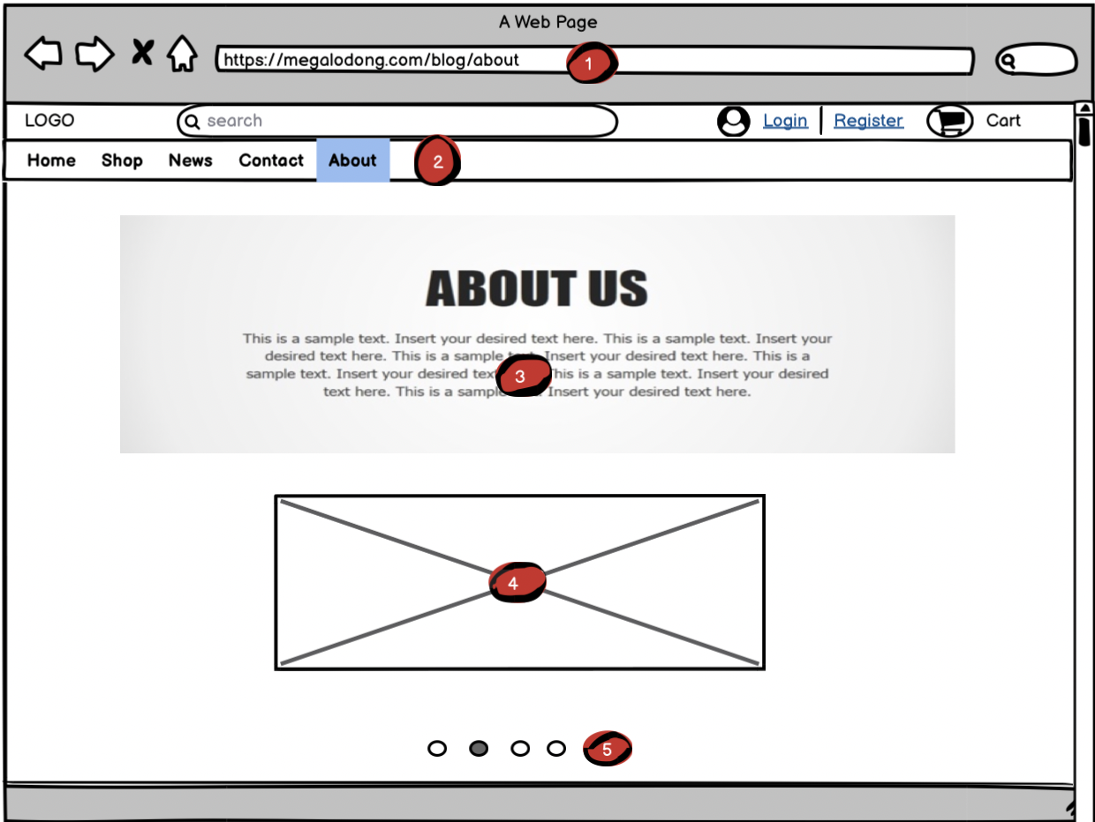
about
DESCRIPTION (About)
1. Firstly, visit the link to the Homepage.
2.Click “About” to access this section page.
3.The information will shaded with your each mouse’s move.
4. Same as step 3
5. If you want to see another section, move your mouse in here.

